Slide 1
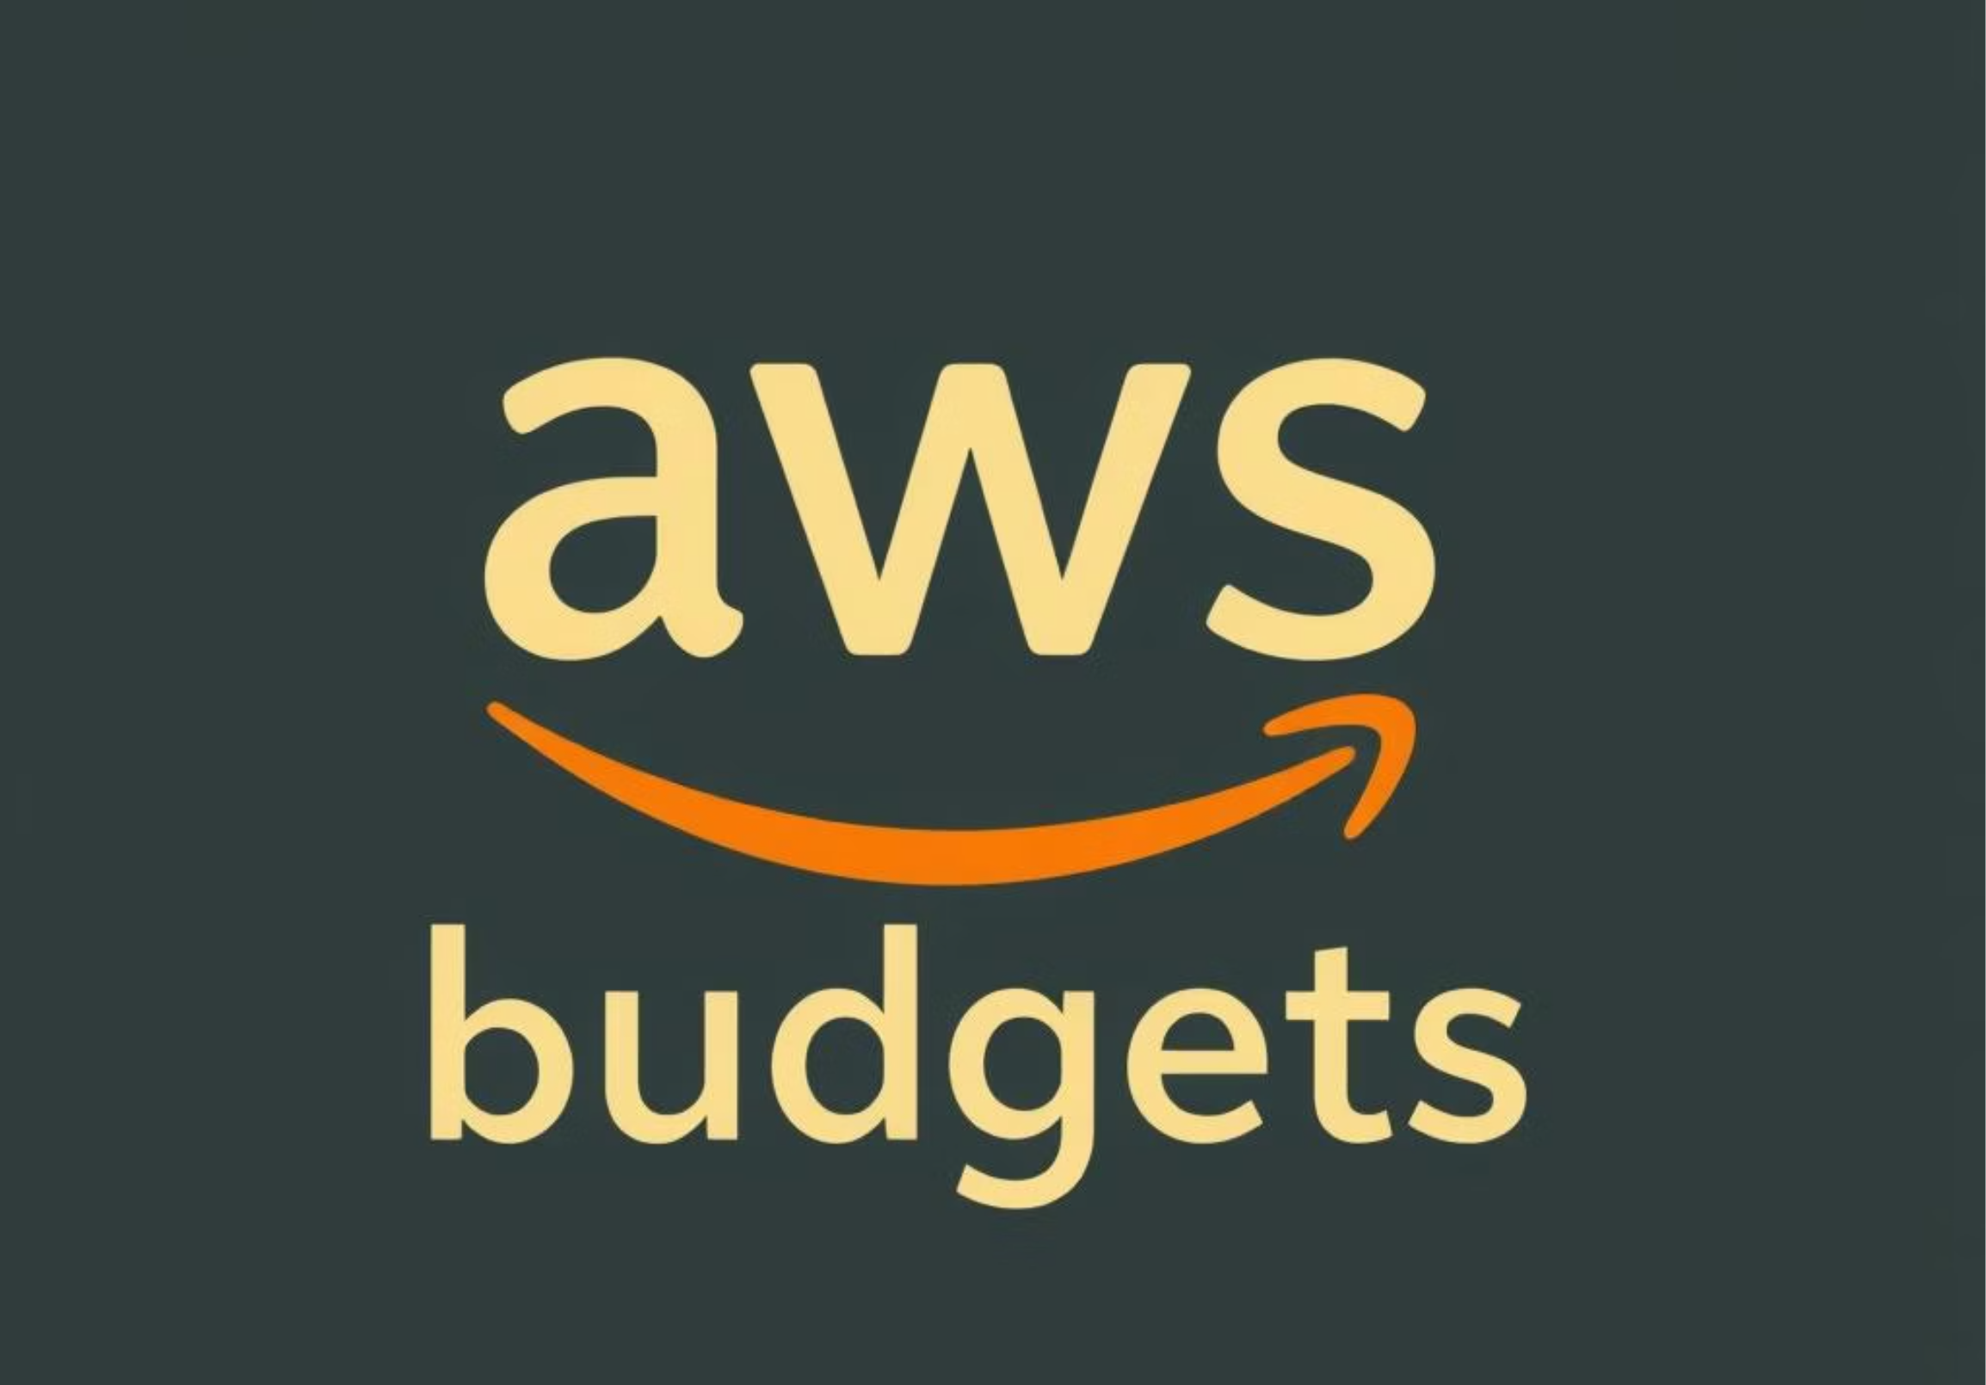
AWS BUDGETS

Slide 2

AWS Budgets: Managing Your Cloud Costs Effectively
Proactive monitoring and control of AWS spending.
Alerts on actual and forecasted budget breaches.

Slide 3



What is AWS Budgets?
Track Costs & Usage
Flexible Budget Types
Daily Updates
Custom budgets for precise financial oversight.
Fixed, variable, or auto-adjusted options.
Budget data refreshes up to 3 times daily for accuracy.

Slide 4



Types of AWS Budgets
Cost Budgets
Usage Budgets
RI & Savings Plans
Track spending limits across services and accounts.
Monitor resource consumption volumes (e.g., EC2 hours).
Track Reserved Instances and Savings Plans efficiency.

Slide 5
Creating a Budget: Step-by-Step
Choose Type & Period
Access Console
Daily, monthly, quarterly, or annually.
AWS Cost Management > Budgets.
Apply Filters
Define Amount
By service, account, region, or tags.
Fixed or planned variable budget.

Slide 6

Budget Notifications and Alerts
Configure Alerts
For actual or forecasted threshold breaches.
Delivery Channels
Email and Amazon SNS topics.
Threshold Examples
80% usage alert, forecasted overspend warning.

Slide 7



AWS Budget Actions: Automate Cost Controls
Automate Responses
Restrict Provisioning
Approval Workflows
Trigger actions on budget breaches.
Via IAM policies to control resource creation.
Support for manual approval of actions.

Slide 8
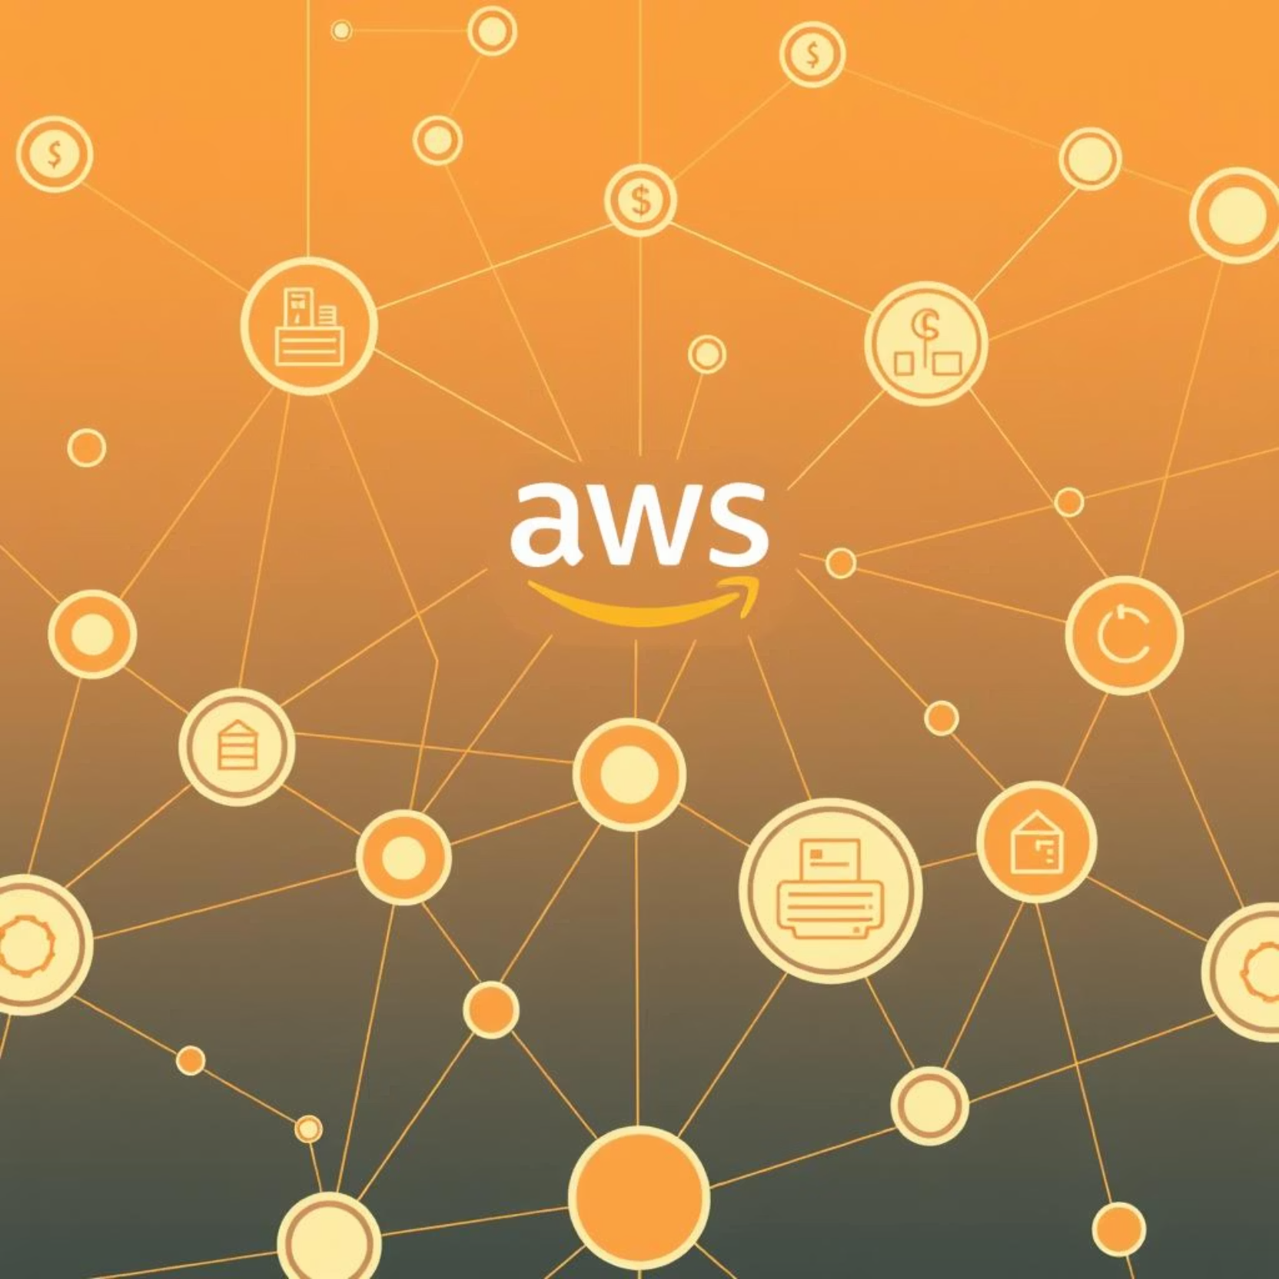
Integration with AWS Services
AWS Cost Explorer: Visualize cost and usage trends for deep insights.
AWS Chatbot: Receive budget alerts directly in Slack or Amazon Chime.
AWS Service Catalog: Track costs on approved products and services.

Slide 9
Best Practices for AWS Budgets
1
Granular Budgets
2
Scope Monitoring
Separate budgets per workload or team for detailed tracking.
Use budget scopes for specific services or tags.
3
Regular Review
4
Combine Tools
Adjust budgets based on usage trends and forecasts.
Pair with AWS Cost Explorer for deeper insights.

Slide 10





Cost Optimization Using AWS Budgets
Detect Underutilization
Identify inefficient Reserved Instances and Savings Plans.
Maximize Efficiency
Set utilization thresholds for optimal savings.
Prevent Overspending
Use forecast alerts to avoid unexpected costs.
Dynamic Adjustments
Leverage auto-adjusted budgets for fluctuating usage.

Slide 11
Summary and Next Steps
Proactive Financial Governance
Reduced Overspend Risk
AWS Budgets offer robust control over cloud spending.
Flexible budget types and automated actions ensure compliance.
Comprehensive Cost Management
Actionable Insight
Seamless integration with other AWS tools.
Start with a monthly cost budget and enable alerts today!

Slide 12

THANK YOU

